Slide 1
Early and late calls of convertible bonds: Theory and evidence
Author：Sudipto Sarkar

Slide 2
Abstract
Many convertible bonds are called too early or too late relative to the perfect markets decision rule of Ingersoll (1977a,b). We re-examine the convertible call decision under corporate taxation and possible default prior to maturity.
Our model predicts that early calls will be associated with high coupon and low call premium, dividend income, volatility, tax rate and interest rate; and late calls will be associated with high call premium, dividend income, tax rate and interest rate, and low coupon and volatility. These implications are supported by empirical tests carried out with five years of convertible call data.

Slide 3
Preliminary
Asset value V
risk-free interest rate r
payout rate δ
volatility σ
Bankruptcy costs α
tax rate τ
face value F
coupon rate c
call premium p
conversion ratio x
default-triggering level Θ
call-triggering level V*

Slide 4


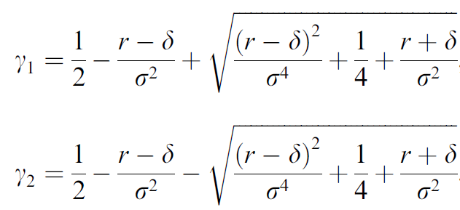
Model
Asset V follow (TP)
Convertible value D(V) satisfy the Cauchy-Euler D.E. (Merton 1973)
→ > 0 < 0

Slide 5


Model
Upper boundary condition
lower boundary condition

Slide 6

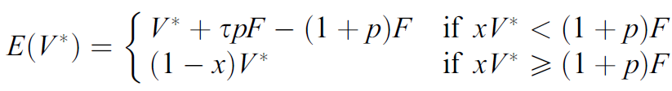

Model (TP)
Valuation of equity with the boundary conditions and
Note： $$\frac{dE(V)}{dV}=\frac{d}{dV}\left[V−\frac{\left(1−τ\right)cF}{r}+V^{γ_{1}}\left(Y_{1}−Z_{1}−X_{1}\right)+V^{γ_{2}}\left(Y_{2}−Z_{2}−X_{2}\right)\right] \\ =1+ γ_{1}V^{(γ_{1}−1)}\left(Y_{1}−Z_{1}−X_{1}\right)+γ_{2}V^{{(γ}_{2}−1)}\left(Y_{2}−Z_{2}−X_{2}\right)$$

Slide 7
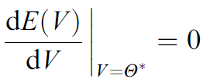

Model (maximize equity value)
Optimal default policies (smooth pasting) Then we have
There being no analytical solution, Eq. has to be solved numerically for the optimal

Slide 8
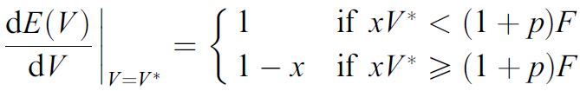
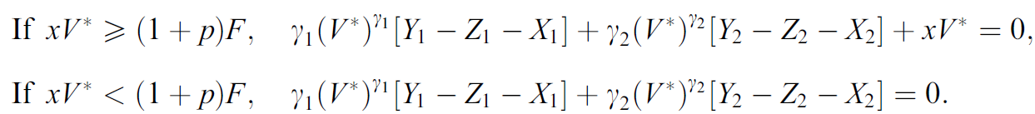
Model (maximize equity value)
Optimal call policies (smooth pasting) We diff. E(V) & setting V = V* , we have Eq. also be solved numerically to compute the optimal call trigger V* (Back)

Slide 9
The base case
Asset value V
risk-free interest rate r = 7%
payout rate δ = 4%
volatility σ = 20%
Bankruptcy costs α = 50%
tax rate τ = 35%
face value F = $100
coupon rate c = 7%
call premium p = 5%
conversion ratio x = 0.2
default-triggering level Θ = 45.1513 (solved numerically)
call-triggering level V* = (1+p)F/x = 525

Slide 10
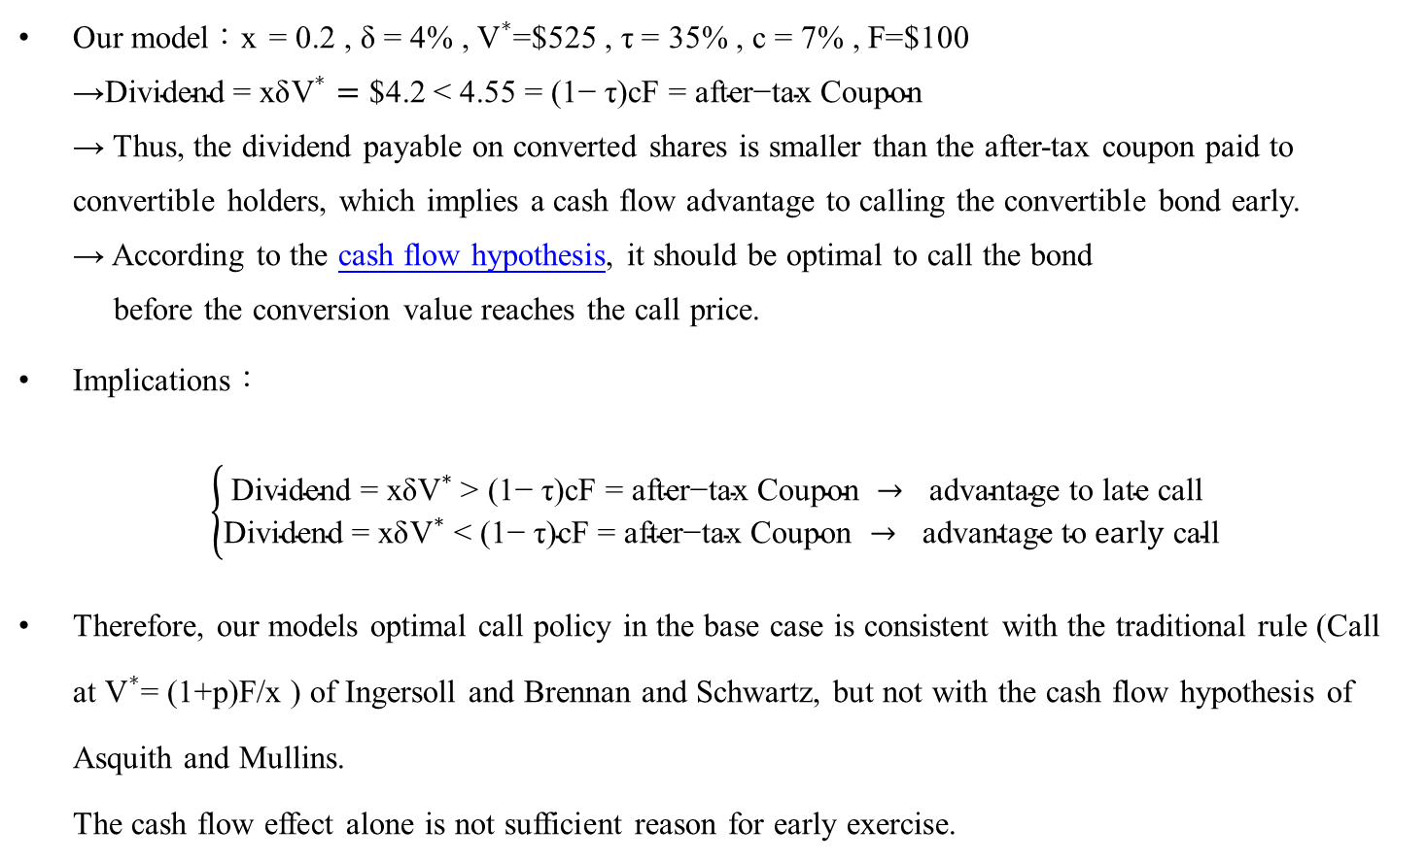
Cash flow hypothesis (Asquith and Mullins, 1991)
Our model：x = 0.2 , δ = 4% , ${\text{V}}^{∗}$=$525 , τ = 35% , c = 7% , F=$100 →$\text{Dividend}\text{ = }\text{xδ}{\text{V}}^{∗}=$ $4.2 < 4.55 = $\text{(1− }\text{τ}\text{)}\text{cF}\text{ = }\text{after}\text{−}\text{tax} \text{Coupon}$ → Thus, the dividend payable on converted shares is smaller than the after-tax coupon paid to convertible holders, which implies a cash flow advantage to calling the convertible bond early. → According to the cash flow hypothesis, it should be optimal to call the bond before the conversion value reaches the call price.
Implications： $\left\{\begin{aligned}\text{Dividend}\text{ = }\text{xδ}{\text{V}}^{∗} \text{> (1− }\text{τ}\text{)}\text{cF}\text{ = }\text{after}\text{−}\text{tax} \text{Coupon} → \text{advantage} \text{to} \text{late} \text{call} \\ \text{Dividend}\text{ = }\text{xδ}{\text{V}}^{∗}\text{ < (1− }\text{τ}\text{)}\text{cF}\text{ = }\text{after}\text{−}\text{tax} \text{Coupon} → \text{advantage} \text{to} early \text{call}\end{aligned}\right.$
Therefore, our models optimal call policy in the base case is consistent with the traditional rule (Call at ${\text{V}}^{∗}$= (1+p)F/x ) of Ingersoll and Brennan and Schwartz, but not with the cash flow hypothesis of Asquith and Mullins. The cash flow effect alone is not sufficient reason for early exercise.

Slide 11

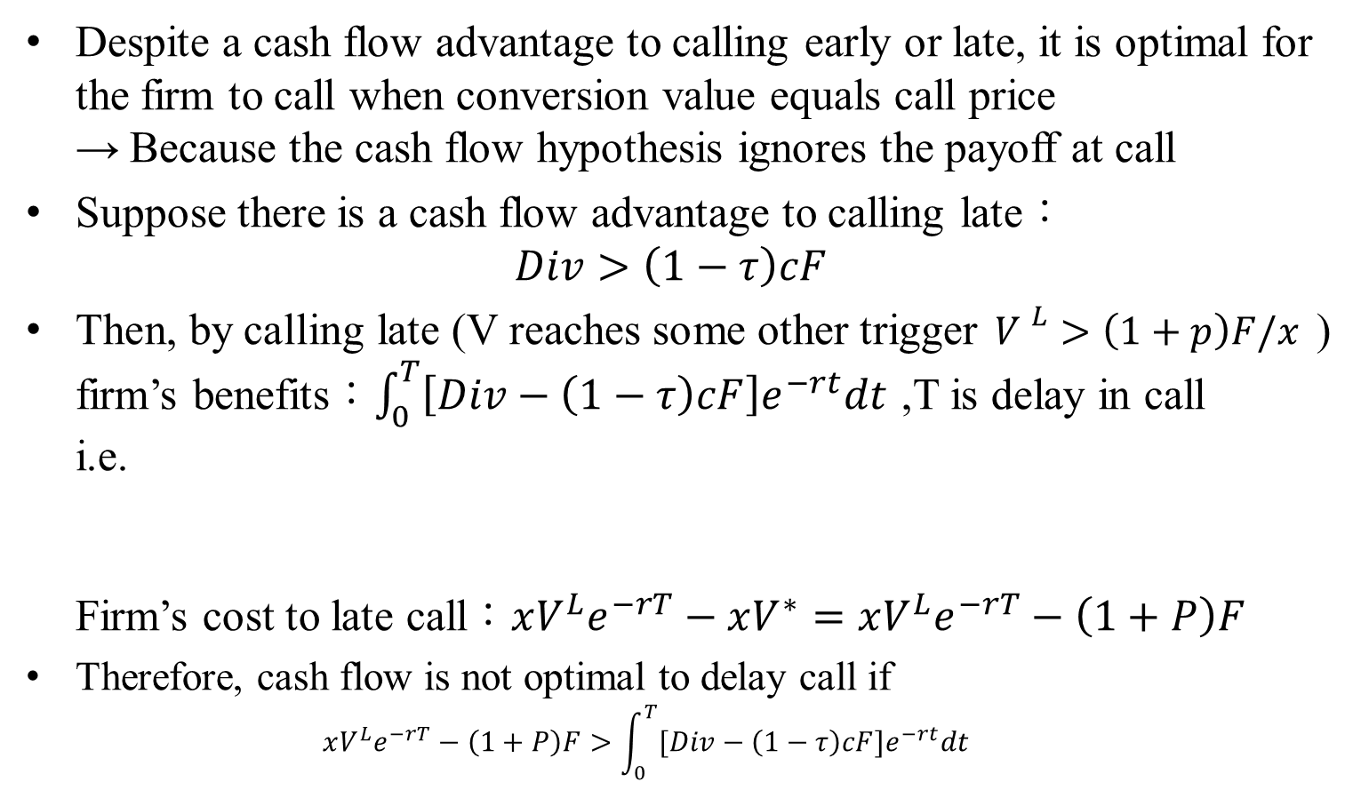

Cash flow hypothesis (Asquith and Mullins, 1991)
Despite a cash flow advantage to calling early or late, it is optimal for the firm to call when conversion value equals call price → Because the cash flow hypothesis ignores the payoff at call
Suppose there is a cash flow advantage to calling late： $Div>\left(1−τ\right)cF$
Then, by calling late (V reaches some other trigger ${V }^{L}>\left(1+p\right)F/x$ ) firm’s benefits：$\int_{0}^{T}{\left[Div−\left(1−τ\right)cF\right]e^{−rt}dt}$ ,T is delay in call i.e. Firm’s cost to late call：$xV^{L}e^{−rT}−xV^{∗}=xV^{L}e^{−rT}−\left(1+P\right)F$
Therefore, cash flow is not optimal to delay call if $xV^{L}e^{−rT}−\left(1+P\right)F>\int_{0}^{T}{[Div−\left(1−τ\right)cF]e^{−rt}dt}$
0
T
t
$$V^{∗}=\left(1+P\right)F/x$$
$${V }^{L}>\left(1+p\right)F/x$$

Slide 12

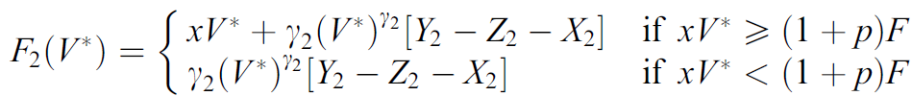

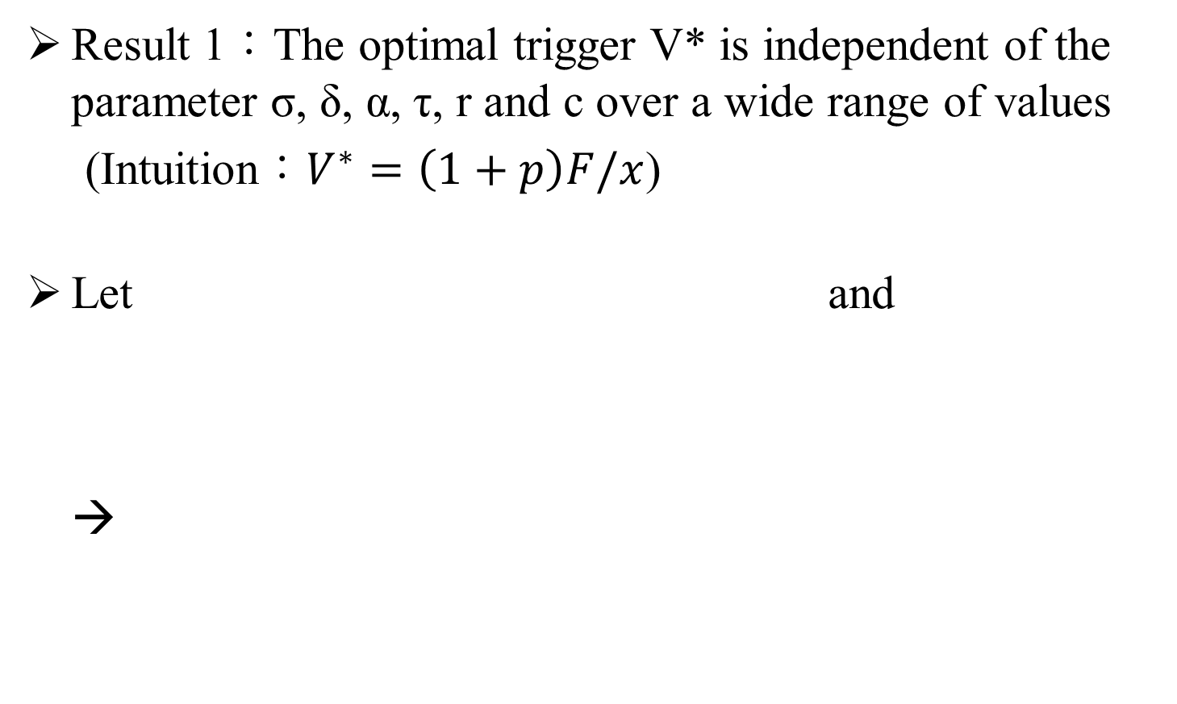
Founding (TP)
Result 1：The optimal trigger V* is independent of the parameter σ, δ, α, τ, r and c over a wide range of values
(Intuition：$V^{∗}=\left(1+p\right)F/x$)
Let and →

Slide 13
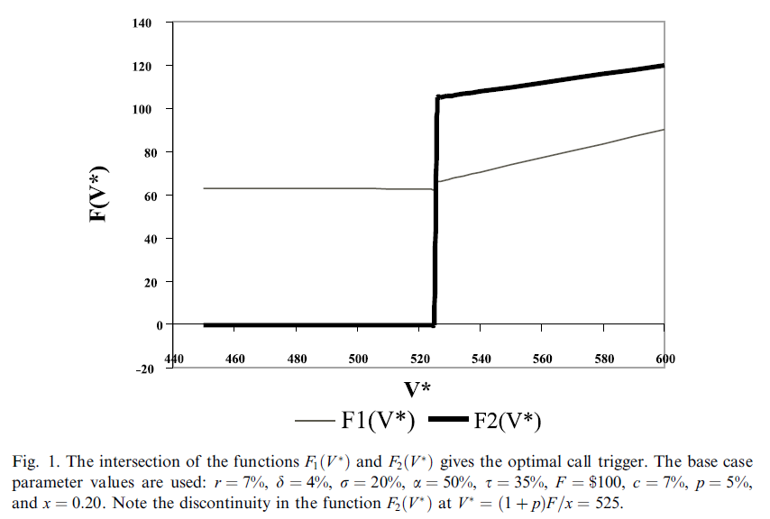
The stickiness in V* comes from the discontinuity caused by the difference in payoffs between in-the-money and out-of-the-money calls.

Slide 14
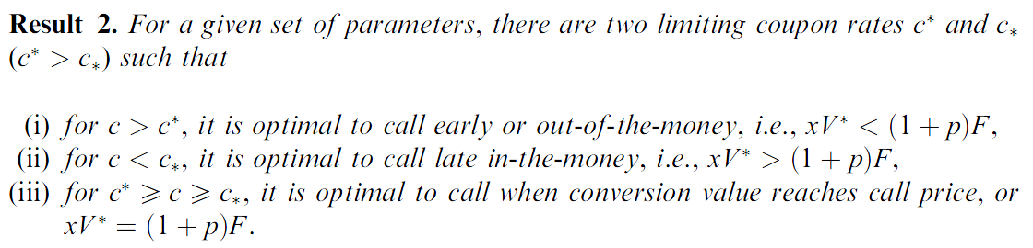
Found
.
In base case ：when c below 4.83% , V* → ∞ (i.e. optimal to delay call) when c above 11.23% , V* < 525 (i.e. optimal to early call →cash flow hypothesis) Therefore, when 4.83%≦ c ≦11.23% , V*=525 (i.e. consistent with perfect market rule)

Slide 15




In Base Case
$c_{∗}=4.83\% , c^{∗}=11.23\%$
$$c_{∗}=4.83\%$$
$$c^{∗}=11.23\%$$
c
Optimal to delay call
(Cash flow hypothesis)
Optimal to early call
(Cash flow hypothesis)
Optimal to call at $V^{∗}=525$

Slide 16

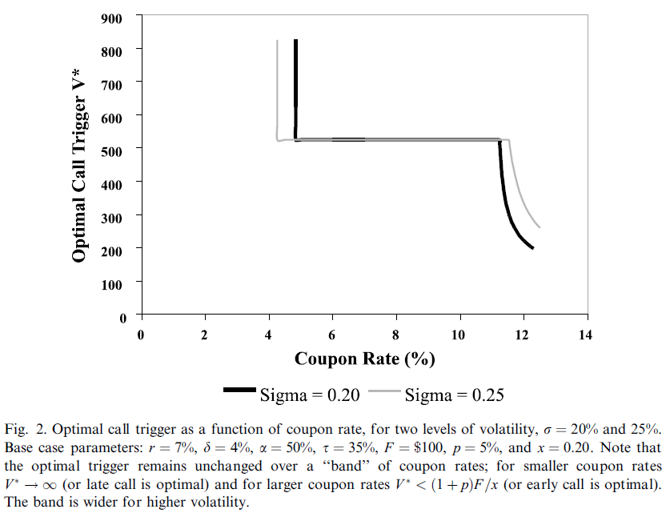
Factors affecting the

Slide 17
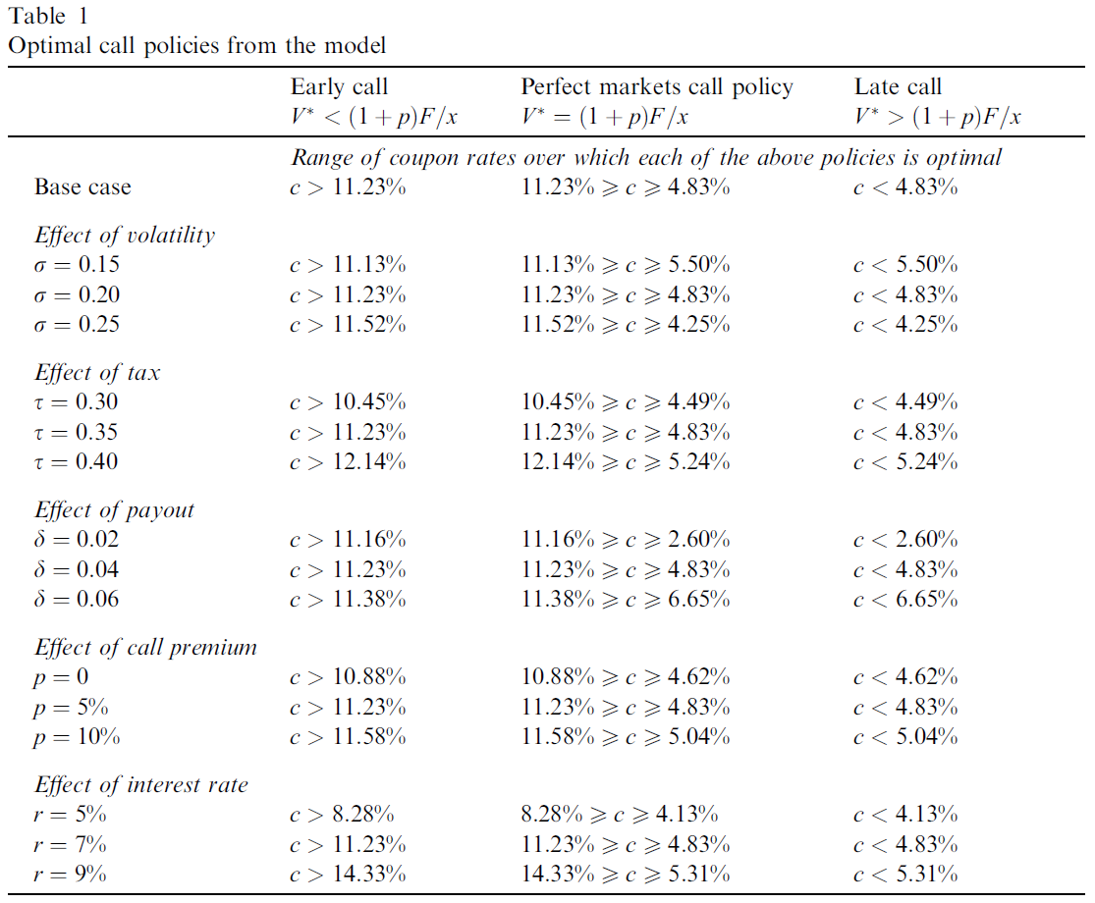

Slide 18
Factors affecting the optimal call policy
Effect of volatility σ ：The “interval” widens as the volatility increases.(σ越大,越不可能late call & early call)
Effect of corporate tax rate τ ：(τ越高 , 越可能late call)
Effect of payout rate δ ： (δ越高 , 越可能late call)
Effect of call premium p ： (p越高 , 越可能late call)
Effect of interest rate r ： (r越高 , 越可能late call)

Slide 19


Summary
In deriving the optimal call policy, we maximize equity value rather than minimize the value of the convertible bond or the conversion option.
Our model shows that neither the contingent-claims model of Ingersoll (1977a) or Brennan and Schwartz (1977) nor the cash flow hypothesis of Asquith and Mullins (1991) is always applicable. In certain scenarios, the perfect markets rule of calling as soon as conversion value reaches call price is indeed optimal, but in other scenarios it is optimal to call before or after the conversion value reaches the call price.
Main results:
It is optimal to call early when the coupon rate is above a certain upper limit
It is optimal to call late when the coupon rate is below a certain lower limit
when the coupon rate is between these two limits, it is optimal to call in accordance with the perfect markets rule.

Slide 20
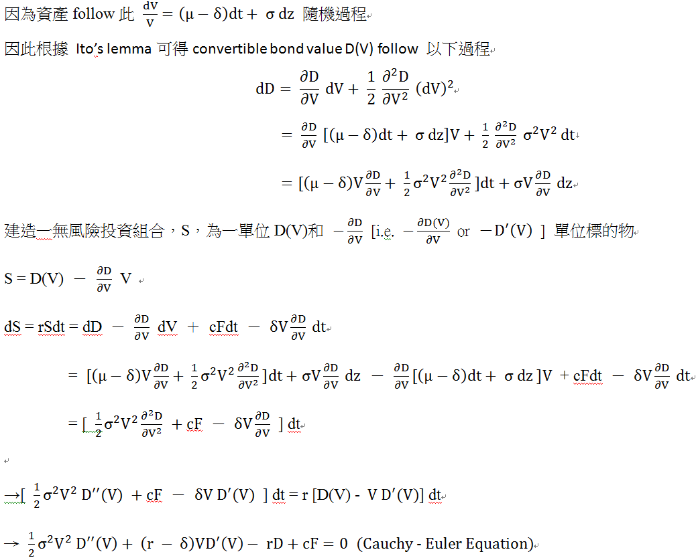
Cauchy-Euler D.E. (Back)

Slide 21
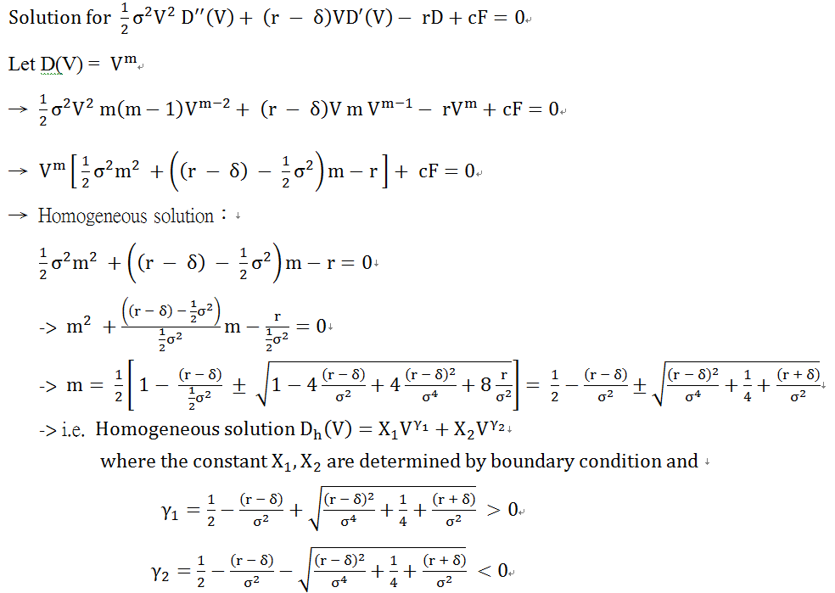
.

Slide 22
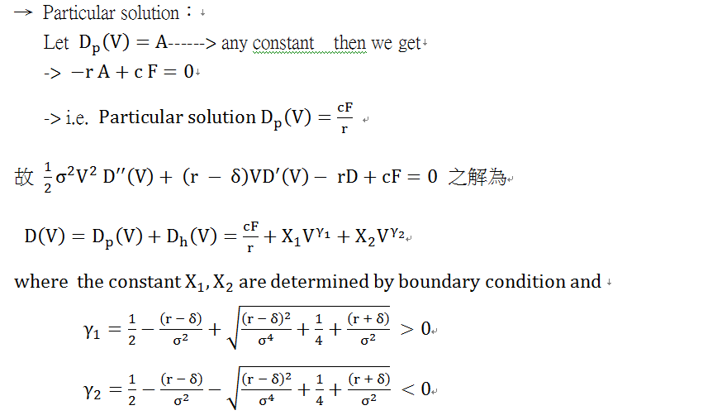
(back)

Slide 23
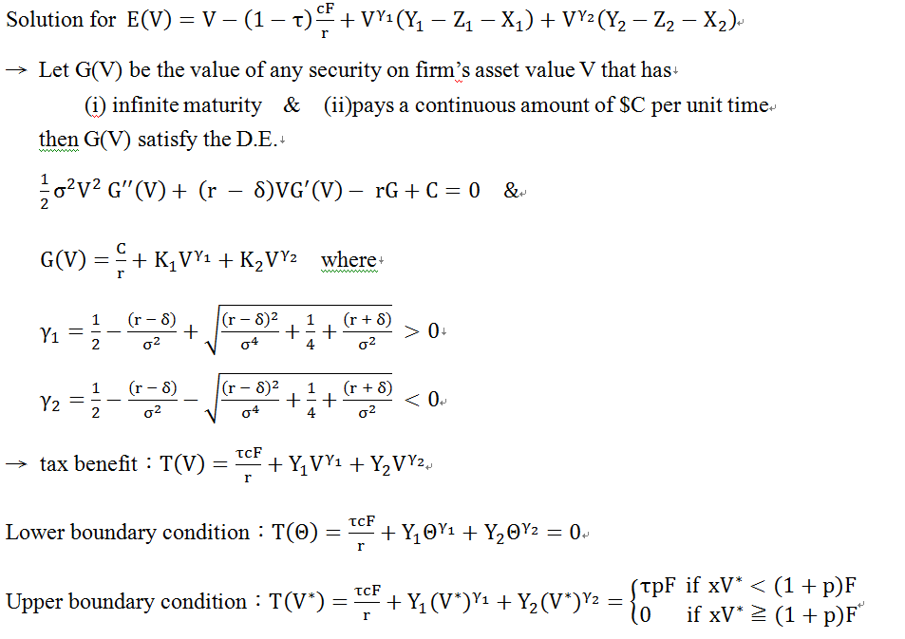
Valuation of equity (Back)

Slide 24
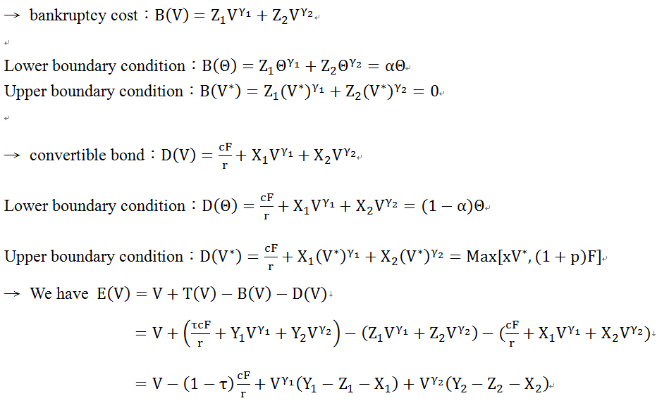
Valuation of equity (Back)

